Slide 1

Seminar Presentation
Presented By
Asif Navas
Roll no : 7
School Of Computer Sciences
Mahatma Gandhi University

Slide 2

HISTORY
2
School Of Computer Sciences, Mahatma Gandhi University

Slide 3






Second World War
3
Germany
Britain
Italy
France
Japan
School Of Computer Sciences, Mahatma Gandhi University

Slide 4
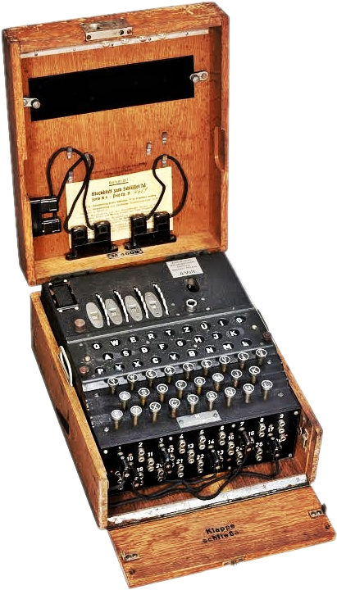
ENIGMA
4
School Of Computer Sciences, Mahatma Gandhi University

Slide 5
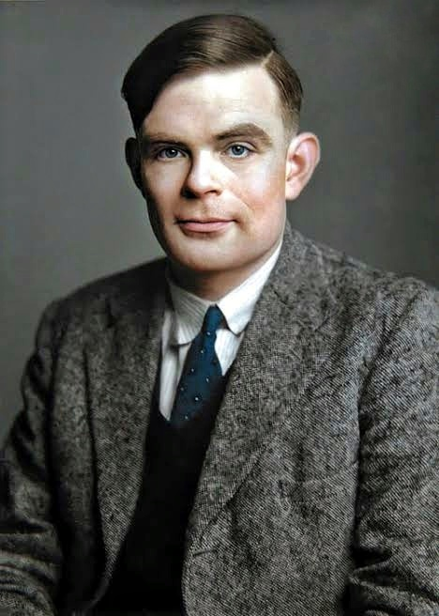
ALLEN TURNING
5
School Of Computer Sciences, Mahatma Gandhi University

Slide 6
Allen Turning’s Concepts
6
“Do machines can Think like a human”
“How a machine can Think like a human”
“Why machines can’t think Like a Human”
School Of Computer Sciences, Mahatma Gandhi University

Slide 7
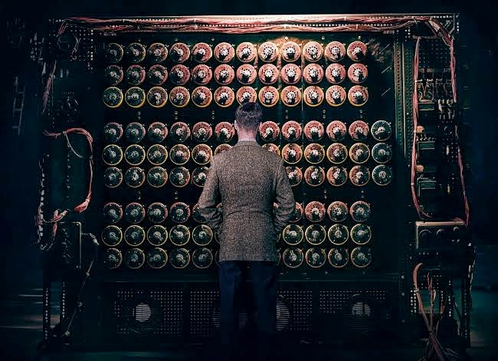
BOMBE
7
School Of Computer Sciences, Mahatma Gandhi University

Slide 8

THE IMITATION GAME
8
School Of Computer Sciences, Mahatma Gandhi University

Slide 9
ARTIFICIAL INTELLIGENCE
9
School Of Computer Sciences, Mahatma Gandhi University

Slide 10
What Is An Artificial Intelligence….?
Artificial intelligence (AI), is intelligence demonstrated by machines, unlike the natural intelligence displayed by humans and animals, which involves consciousness and emotionality. By using a set of programs.
School Of Computer Sciences, Mahatma Gandhi University

Slide 11

Intelligent Resource Management in Future Wireless Networks Inspired by Artificial Intelligence
11
School Of Computer Sciences, Mahatma Gandhi University

Slide 12
Contents
12
INTRODUCTION
OBJECTIVE
METHODOLOGY
RESULT AND ANALYSIS
CONCLUSION
REFERENCES
School Of Computer Sciences, Mahatma Gandhi University

Slide 13
INTRODUCTION
13
The number and complexity of tasks in the network are increasing sharply, but at the same time volume of edge resources is limited.
Major challenge in network management is the diversification of network resources .
Many traditional resource optimization method in wireless communication network are becoming more performance-constrained and complicated in complex scenarios.
How to provide the most efficient service for network users with limited resources is an urgent problem to be solved.
School Of Computer Sciences, Mahatma Gandhi University

Slide 14
INTRODUCTION
14
Development of Artificial intelligence helped to solve complex decision-making problems.
AI algorithms have been applied to joint resource allocation problems to solve complex decision-making problems.
Various AI technologies, mainly machine learning and deep learning, can extract useful information from wireless systems, learn and make decisions from dynamic environments and are considered as possible solutions for complex and previously intractable problems in future wireless networks.
School Of Computer Sciences, Mahatma Gandhi University

Slide 15
Objective
The objective is to solve the complicated decision making problem and to improve the efficiency and performance of the network.
Intelligent Resource Management in Future Wireless Networks Inspired by Artificial Intelligence is a new technology for future wireless network to improve network performance, including reducing computation delay, transmission delay and bandwidth consumption. .A 5G based AI-assisted intelligent wireless network architecture is given, based on the architecture, Deep Q-network (DQN) algorithm is used to figure out Joint Resource Allocation.
School Of Computer Sciences, Mahatma Gandhi University

Slide 16
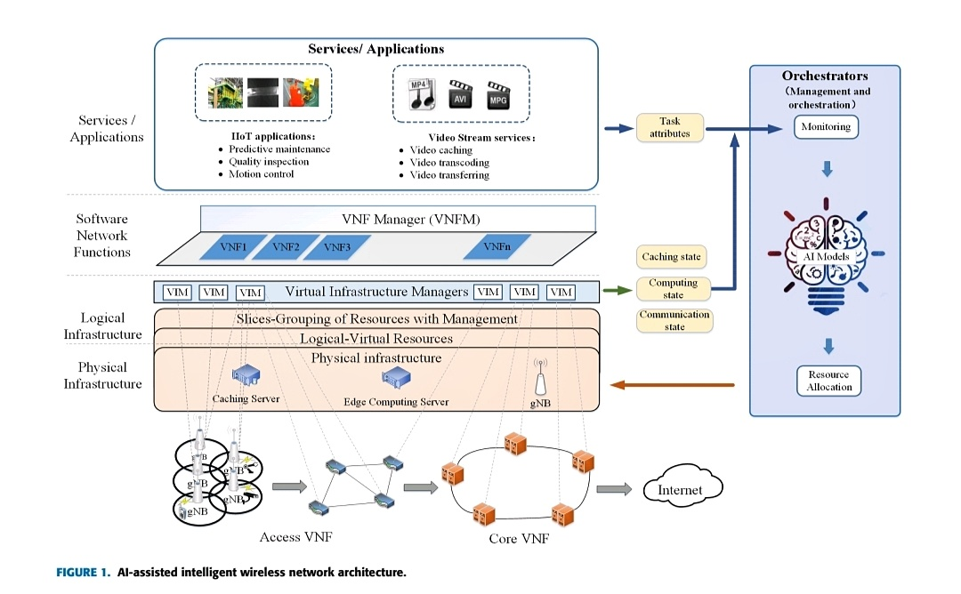
ARCHITECTURE OF 5G-BASED AI-ASSISTED INTELLIGENT WIRELESS NETWORK
16
School Of Computer Sciences, Mahatma Gandhi University

Slide 17
17
The system architecture is divided into four parts
Physical Infrastructure
It consists of caching servers, edge computing servers and gNodeB.
Logical Infrastructure
The physical infrastructures are abstract into logical-virtual resources in the logical infrastructure layer.
Software Network Functions
In the software network functions layer, Virtual Network Functions are software that provide some kinds of network services. And Virtual Network Function Manager is responsible for Virtual Network Function lifecycle management.
Orchestrators
It is responsible for organizing infrastructures based on the tasks attribute and resource status.
School Of Computer Sciences, Mahatma Gandhi University

Slide 18
AI FOR RESOURCE ALLOCATION PROBLEM
18
Supervised Learning & Unsupervised Learning
Reinforcement Learning
Deep Reinforcement Learning
Deep Learning
School Of Computer Sciences, Mahatma Gandhi University

Slide 19
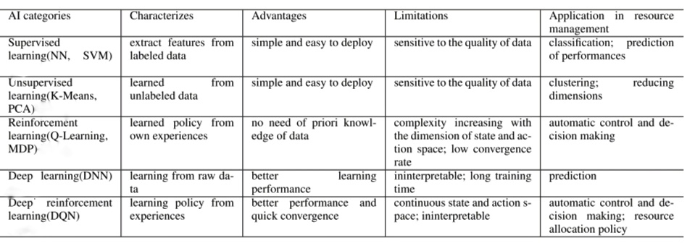
SUMMARIZED OF AI-BASED APPROACHES USED IN RESOURCE MANAGEMENT
School Of Computer Sciences, Mahatma Gandhi University

Slide 20
methodology
Aim : To solve the joint resource allocation problem and to improve the efficiency and performance of the network.
To achieve the objective DEEP Q-NETWORK (DQN) Algorithm is used.
DQN is a type of reinforcement learning that differs from traditional tabular RL algorithms.
DQN requires a data set to train neural networks.
DQN's data set comes from the interaction between the agent and the environment.
A portion of the data generated from each interaction is stored and used to train the neural network.
However, The order of data is Interrelated.
In order to train neural networks, interconnections need to be removed.
Thus, the Experience Replay mechanism is introduced.
School Of Computer Sciences, Mahatma Gandhi University

Slide 21
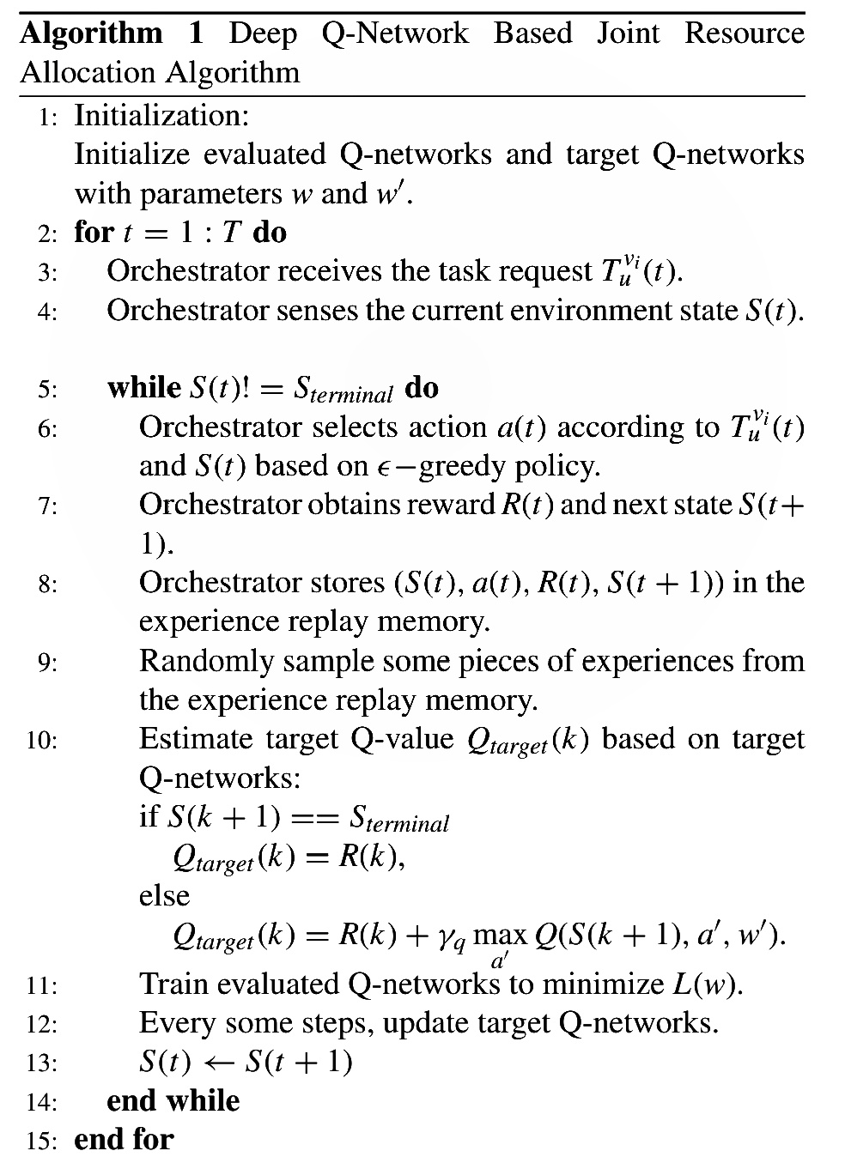
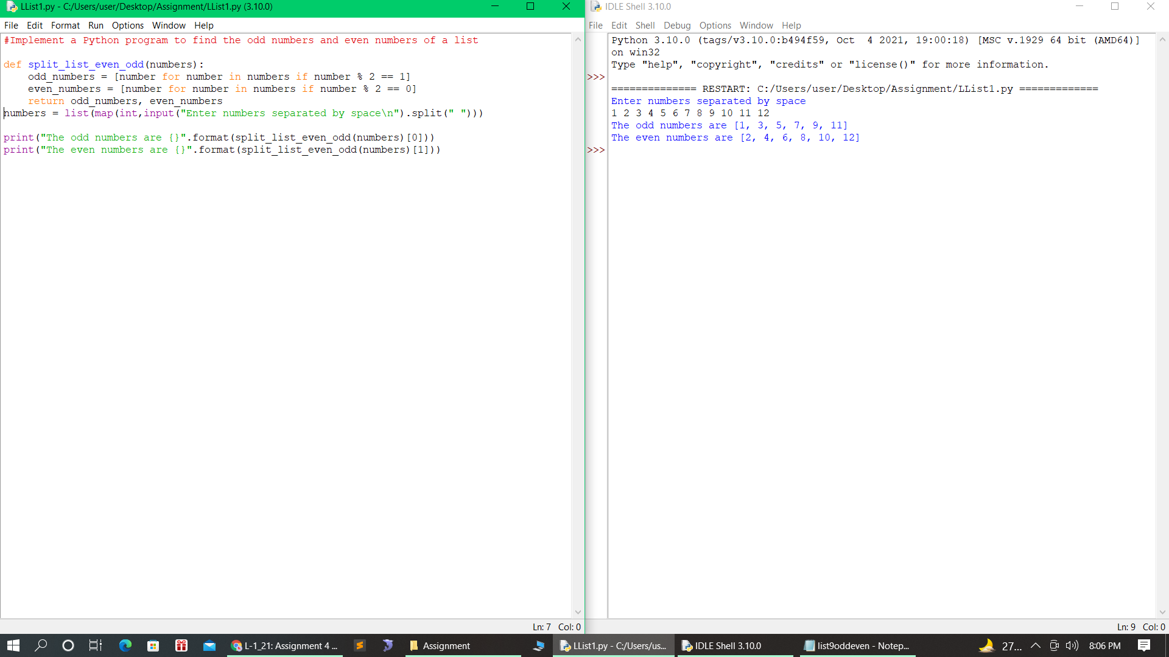
methodology
DEEP Q-NETWORK BASED JOINT RESOURCE ALLOCATION ALGORITHM
School Of Computer Sciences, Mahatma Gandhi University

Slide 22
RESULTS AND ANALYSIS
The DQN-based integrated resource allocation algorithm aims to optimize resource allocation decisions based on task attributes and resource status.
Here, analyze the DQN based integrated resource management algorithm in two steps.
1. The cohesiveness performance is analyzed.
2. Analyze the performance of the algorithm to improve system reward.
At the beginning of the simulation, we start with the State Transition Probability Metrics to show the computing, caching, and communication status.
Here, compare the performance of four simulation schemes.
• DQN based joint allocation scheme.
• DQN based scheme except edge computing.
• DQN based scheme except caching.
• Static allocation scheme.
School Of Computer Sciences, Mahatma Gandhi University

Slide 23
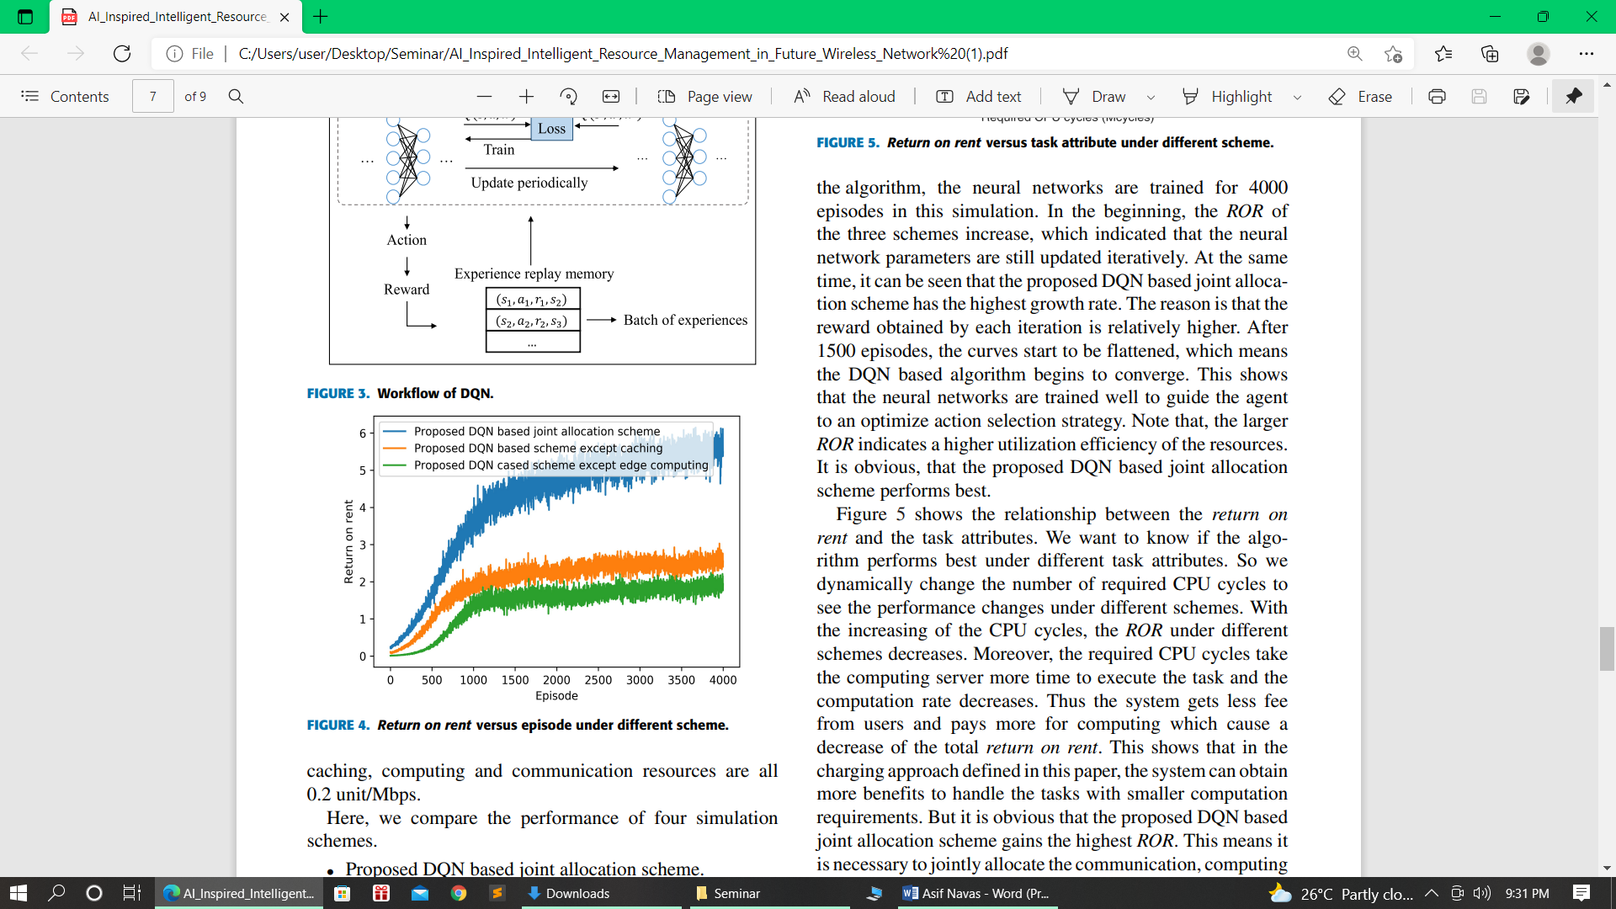
Shows the return on rent varies with the training episodes
To know if the algorithm works well under different task attributes.
Dynamically change the number of CPU cycles required to see the performance changes under different schemes.
As CPU cycles increase, the ROR under different schemes decreases.
Furthermore, the computing server takes longer to execute the task of the required CPU cycles and the computing rate is reduced.
Thus, the system receives lower fees from users and pays more for computing, which reduces the total rental revenue.
The system can achieve greater benefits in handling tasks with smaller computing requirements.
It is clear that the DQN-based joint allocation scheme achieves the highest ROR.
School Of Computer Sciences, Mahatma Gandhi University

Slide 24
CONCLUSION
By studying the environmental status and task attributes through algorithms, the Al-Algorithm-based orchestrator is able to allocate resources to different situations.
An AI-Assisted Intelligent Wireless Network Architecture based on 5G was introduced.
The DQN algorithm is used to solve the complex and highly complex resource allocation problem.
The simulation results show that the newly introduced resource allocation scheme has good convergence characteristics.
School Of Computer Sciences, Mahatma Gandhi University

Slide 25
REFERENCES
[1] Sibao Fu; Fan Yang; Ye Xiao "AI Inspired Intelligent Resource Management in Future Wireless Network" IEEE Access,, Volume: 8 Pages: 22425 – 22433, 2020.
[2] Yejian Zhao; Yanhong Wang; Yuanyuan Tan; Jun Zhang; Hongxia Yu “Dynamic Jobshop Scheduling Algorithm Based on Deep Q Network” IEEE Access, Volume:9 Pages: 122995 – 123011, 2021
[3] Yong Cao; Rui Wang; Min Chen; Ahmed Barnawi “AI Agent in Software-Defined Network: Agent-Based Network Service Prediction and Wireless Resource Scheduling Optimization” IEEE Internet of Things Journal, Volume: 7 Pages: 5816 – 5826, 2020.
[4] M. Yao, M. Sohul, V. Marojevic, and J. H. Reed, ‘‘Artificial intelligence defined 5G radio access networks,’’ IEEE Communications Magazine, Volume: 57, Pages: 14–20, 2019.
[5] F. Xu, F. Yang, S. Bao, and C. Zhao, ‘‘DQN inspired joint computing and caching resource allocation approach for software defined information-centric Internet of Things network,’’ IEEE Access, Volume: 7, Pages: 61987–61996, 2019.
School Of Computer Sciences, Mahatma Gandhi University

Slide 26
26
THANK YOU

